Slide 1

Acoustic Cellos: String and Body Resonances
Samantha Young and Gordon Ramsey

Slide 2
Summary
Spring 2016: Sound data was taken of the acoustic cello to demonstrate the plethora of harmonics
Spring 2017: Extensive sound data was taken from different angles to determine the radiation.
Summer 2017: High speed video was taken of strings to investigate the possibility of motion tracking.
Fall 2017: Video Analysis was performed to connect high speed video to sound measurements

Slide 3
Sound Radiation
Three microphones recorded sound data from three different ‘perspectives’
Intensities measured from each mic were different
Mic 1 (Left) had the lowest sum of intensities
Notes between A₂-G₃ had the lowest percent fundamental
  Theorized resonance of D₃-F₃

Slide 4
High Speed Video
First in 400 fps for trial
  Played open string normally and recorded string movement from stick-slip to decay
  Video analysis from Vernier Logger Pro
While meeting criteria for adequate points, a higher resolution was required
1000 fps is proving to qualitatively look better, though analysis is difficult
While Vernier seems to be sufficient, other analysis programs are being investigated

Slide 5
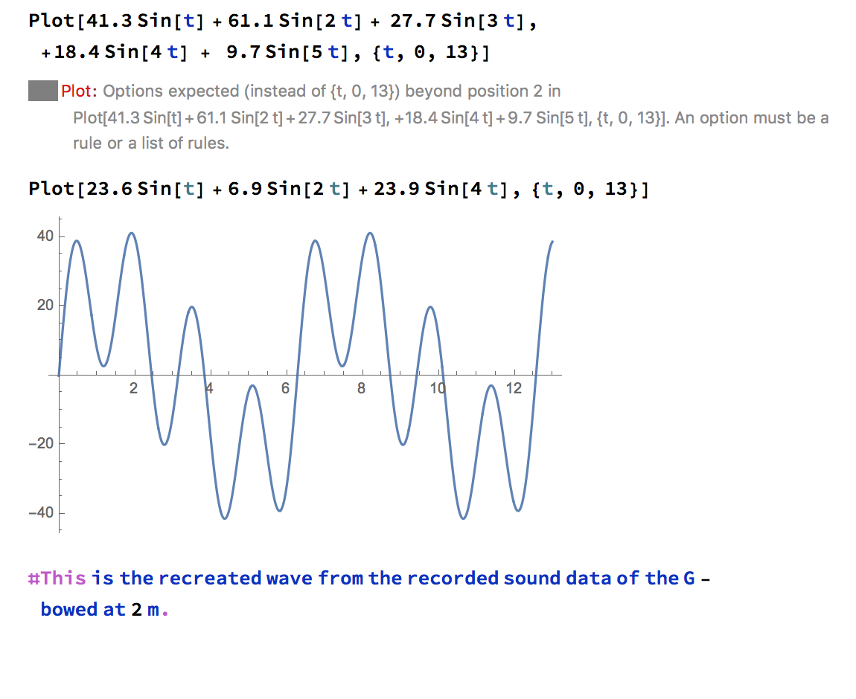
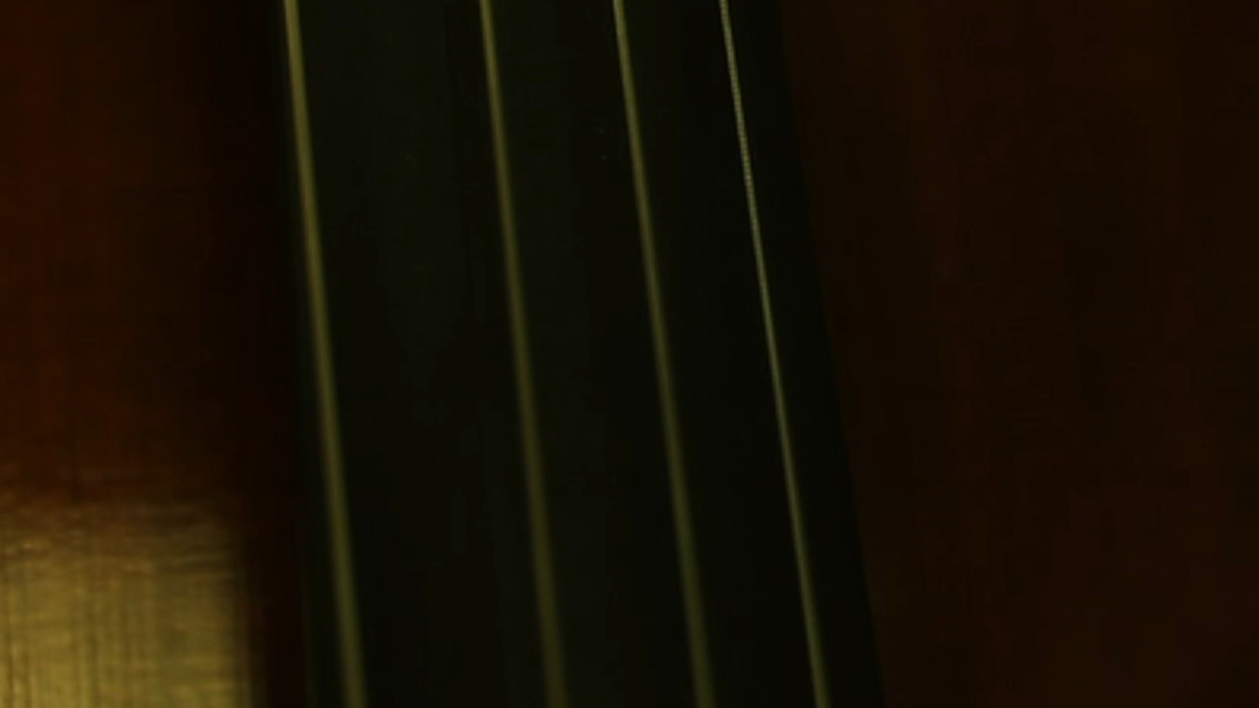
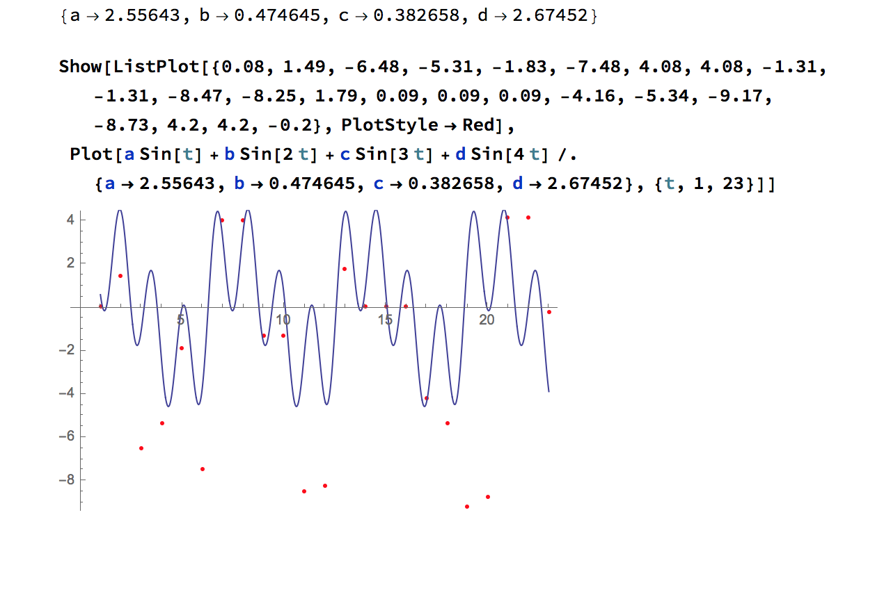
400 fps

Slide 6
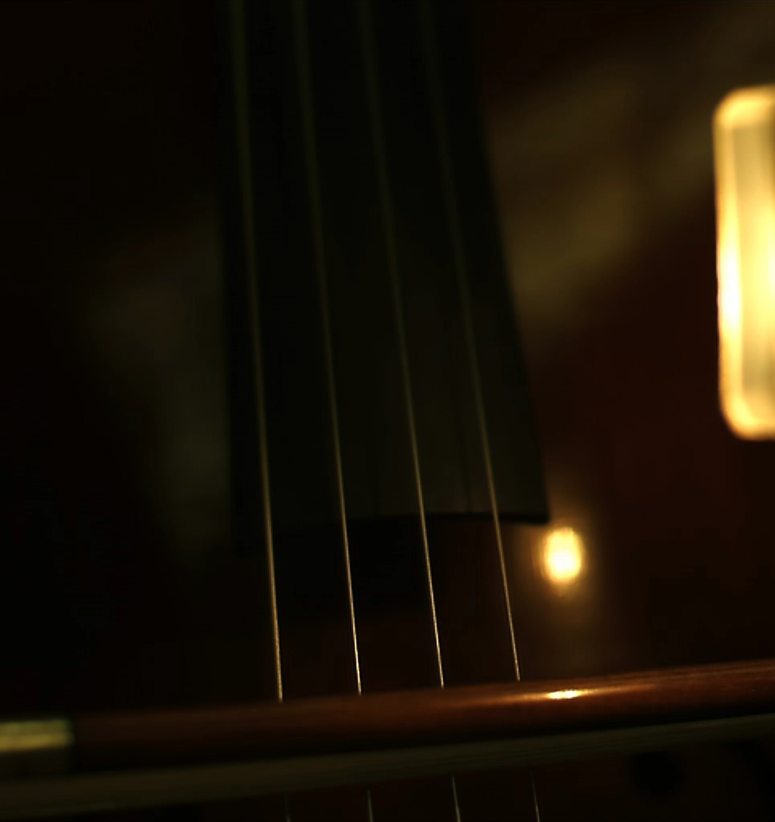
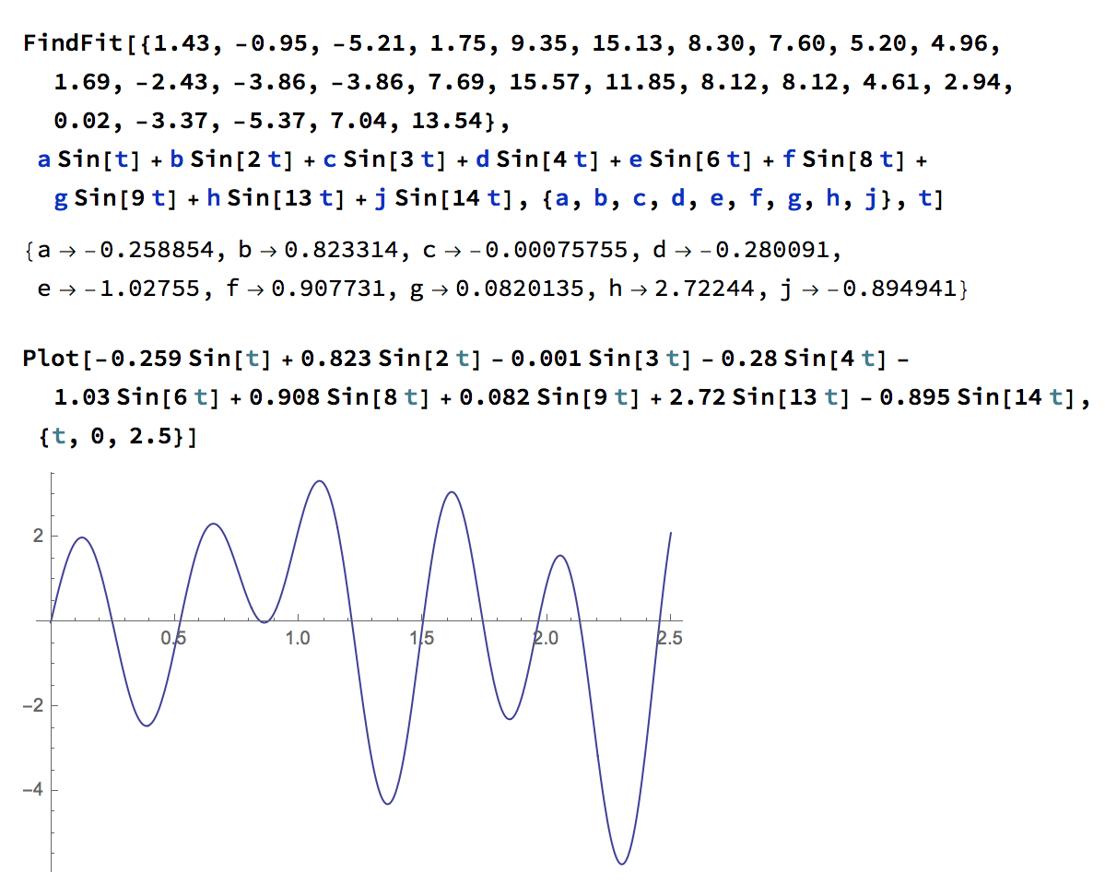
1000 fps

Slide 7
Future Work
We purchased a cheaper full size cello so that we can do more with the body without worry
  Differences in sound measurements will occur
  Can adjust sound post to test differences
  Connect string data to body resonances
We have connected with Northwestern to schedule testing in an anechoic chamber
We are now versed in adjusting the sound post of a cello and can look at the resulting differences in resonances

Slide 8
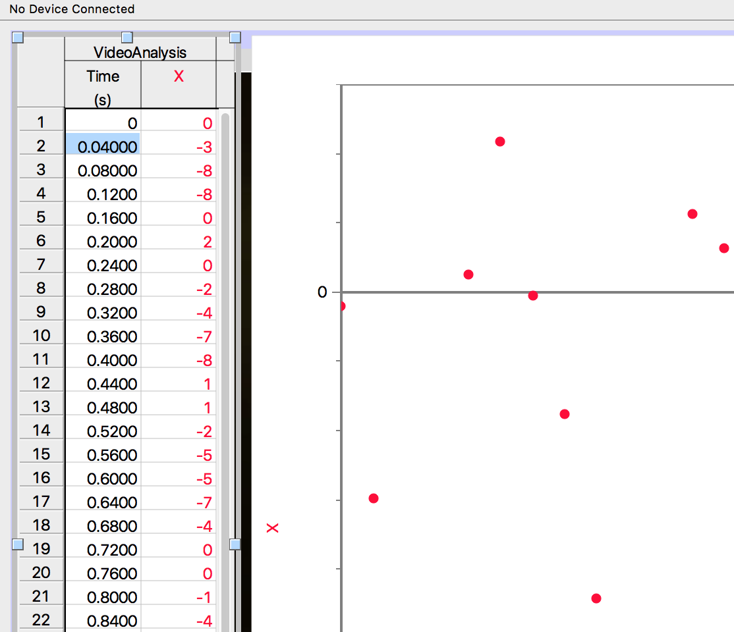
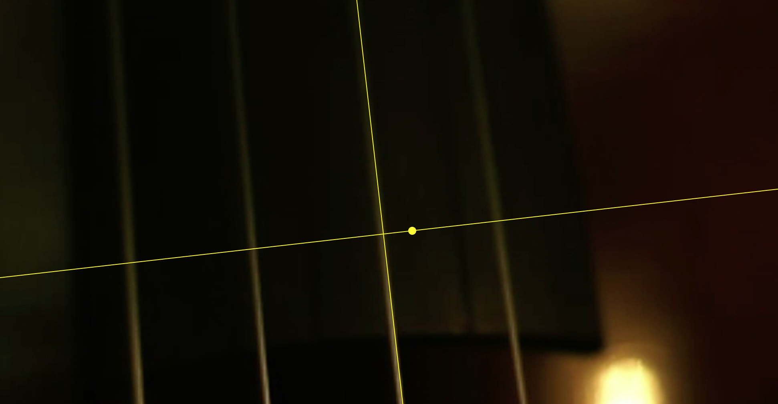
In the Classroom
Logger Pro is available to most classroom settings
Data analysis is an easy procedure
  Vernier provides a good informational article on adding tracking points
Can reproduce the experiments described

